Slide 1


Nature Trail Discovery App
PRESENTED BY:
Benjamin Paul
Shrutika Shriram
Priti Deshmane
GUIDED BY:
Prof. Jayashree Choudhari
Dr. D.Y.PATIL SCHOOL OF ENGINEERING,PUNE
Pin-412105

Slide 2



“Nature Trail Discovery App ”
SPONSORED BY
Centre of Environment Education (CEE)
(CEE is the national institute which is established in August 1984 as a Centre of Excellence, supported by Ministry of Environment , Forest and climate change , Government of India which promotes Environmental Awareness nationwide.)

Slide 3
INDEX
Problem statement
Motivation
Objectives
Literature Review

Slide 4
1.PROBLEM STATEMENT
Nature Trail Discovery App is an android application which will load the location data and display points of interest.
It gives information about a trail(route) and objects ,organisms or structures in the trail when you get in proximity of a certain predefined point.

Slide 5
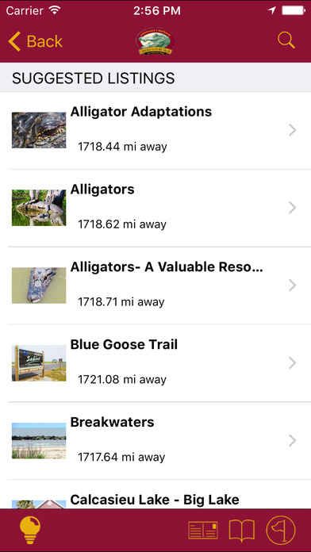
Fig 1.1
List of available trails

Slide 6
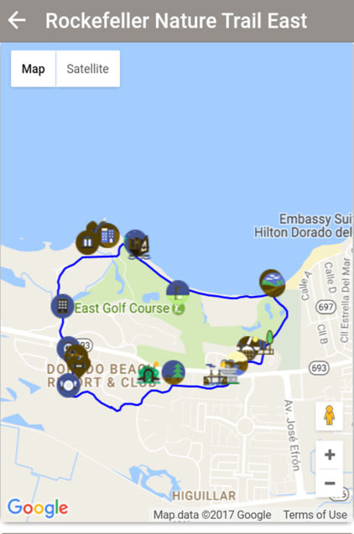
Fig 1.2
Displaying the trail selected

Slide 7
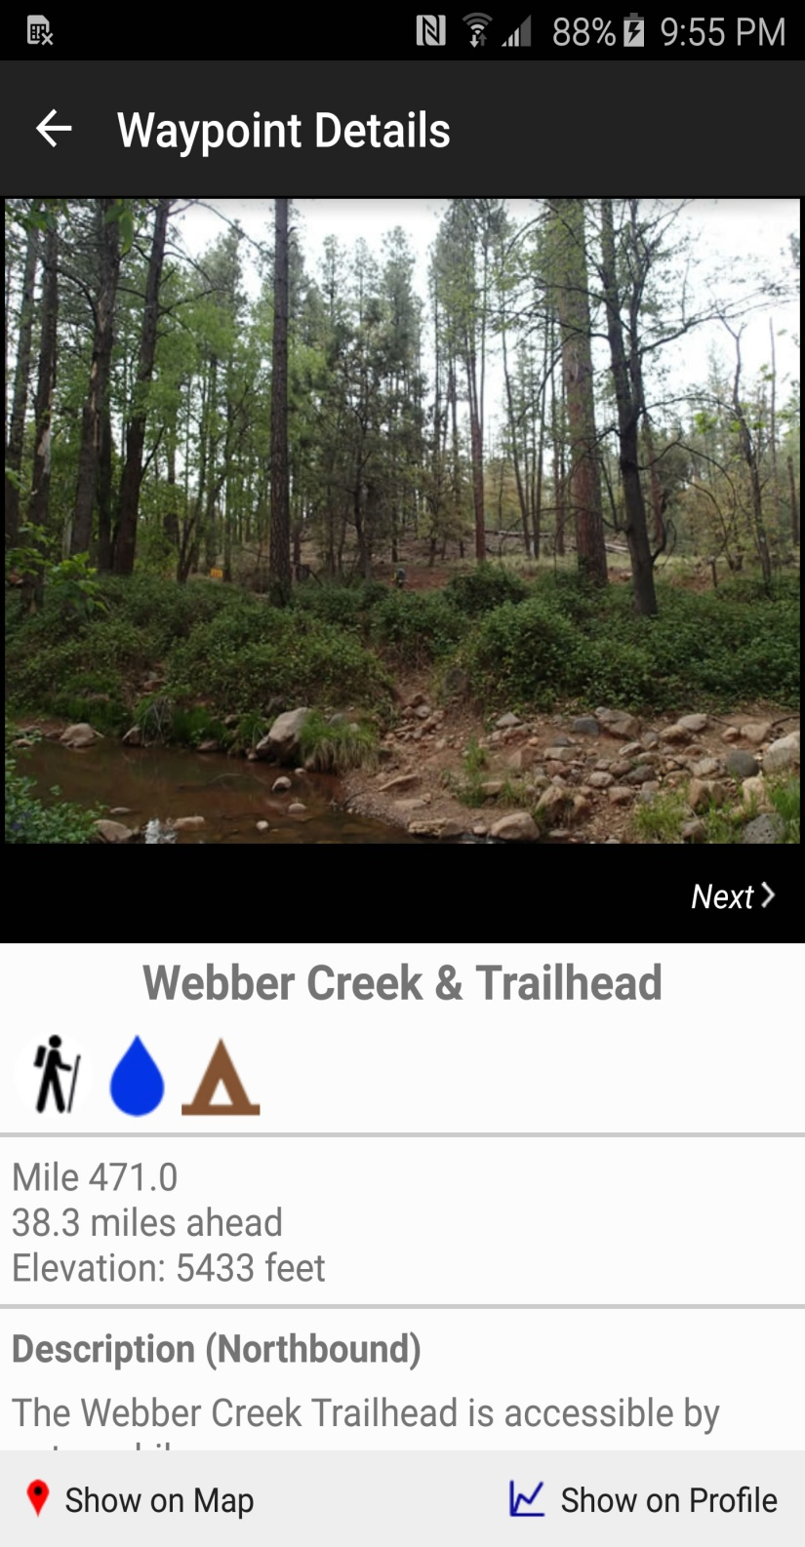
Fig 1.3
Information about a point of interest.

Slide 8
2.MOTIVATION
Nature trail is a part of the project for awareness about urban ecosystems and bird education taken up through Garden Dept and Indradhanushya, and being implemented by CEE along with Ecological Society and others.
This project idea was taken from the Nature Trail which was organized at Pashan lake on 26 January 2017 for school student’s. The trail and onsite activities was organized for 30 students from Tara Mobile Creche. Students were given a specially designed “nature observation notebook”.

Slide 9
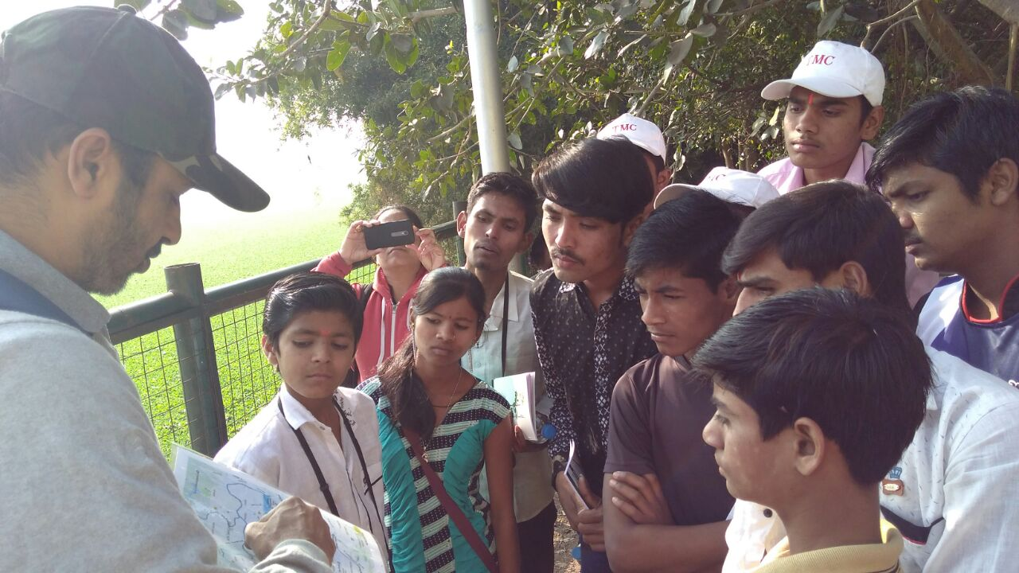
The Trail Activities Conducted By Educators From CEE, Ecological Society
Fig 2.1

Slide 10

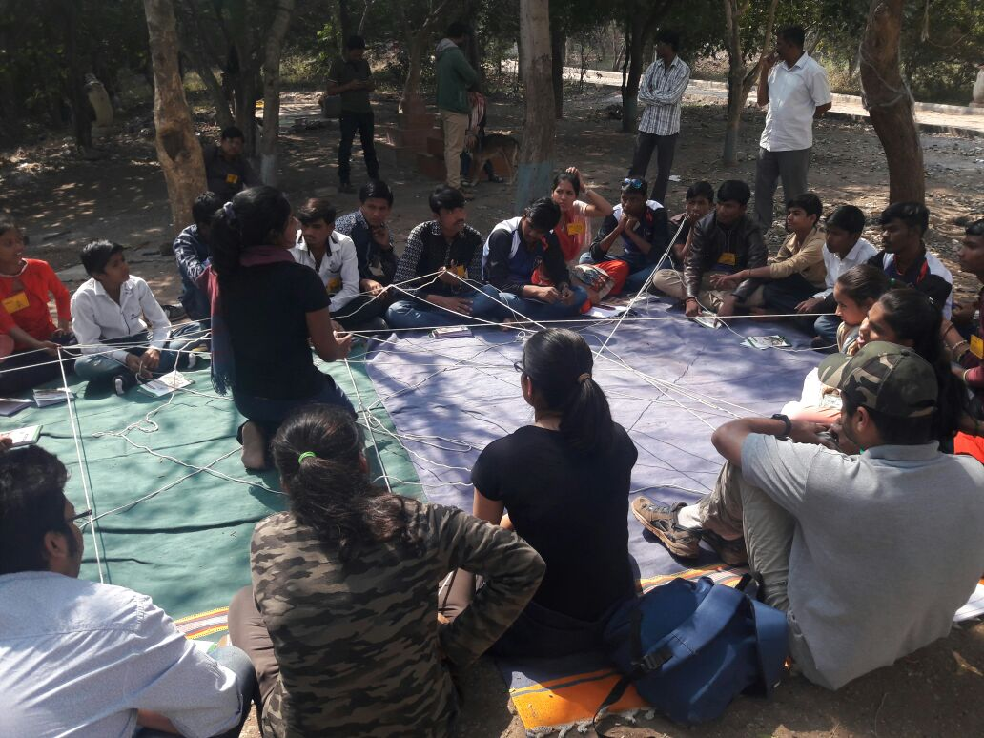

Fig 2.2

Slide 11
3.OBJECTIVES
To make information readily available to the user.
To guide user through unfamiliar location.
To help user identify points of interest and relate to his immediate environment based on the information provided.
To promote environmental education.

Slide 12
4.LITERATURE REVIEW
A similar attempt is been made in the IEEE document number 8001725 published on 8th August 2017 titled location based game development tool kit
According to the paper it has been a norm that learners with their personal devices take an active role through accessing interpreting and processing informational artifacts on the go.

Slide 13
SR.no | Paper Name | Author name | Year | Proposed system
1 | Designing learning experiences in Zoos: A location based game development Toolkit | Ryan Dias | 2017 | The paper discusses the theoretical assumptions and design aspects of developing a tool kit that supports adventure learning .The smart zoo project aims to design and develop a tool set which allows teachers but also students to take an active role in designing location based games , adventure trails and other challenges such a s quiz, assignments etc on personal mobile devices.
Table 4.1

Slide 14
THANK YOU!

